Slide 1
Hadoop and MapReduce Frameworks

Slide 2

Hadoop
Open-source framework that allows to store and process large data set in parallel and distributed manner.
Started in 2001 with increase in popularity of internet which resulted in generation on large volume of data.
It was purposed to easily address problem of storing and processing big data.
In 2008 yahoo declared it as open source.
Was made publicly available by Apache in 2012.

Slide 3
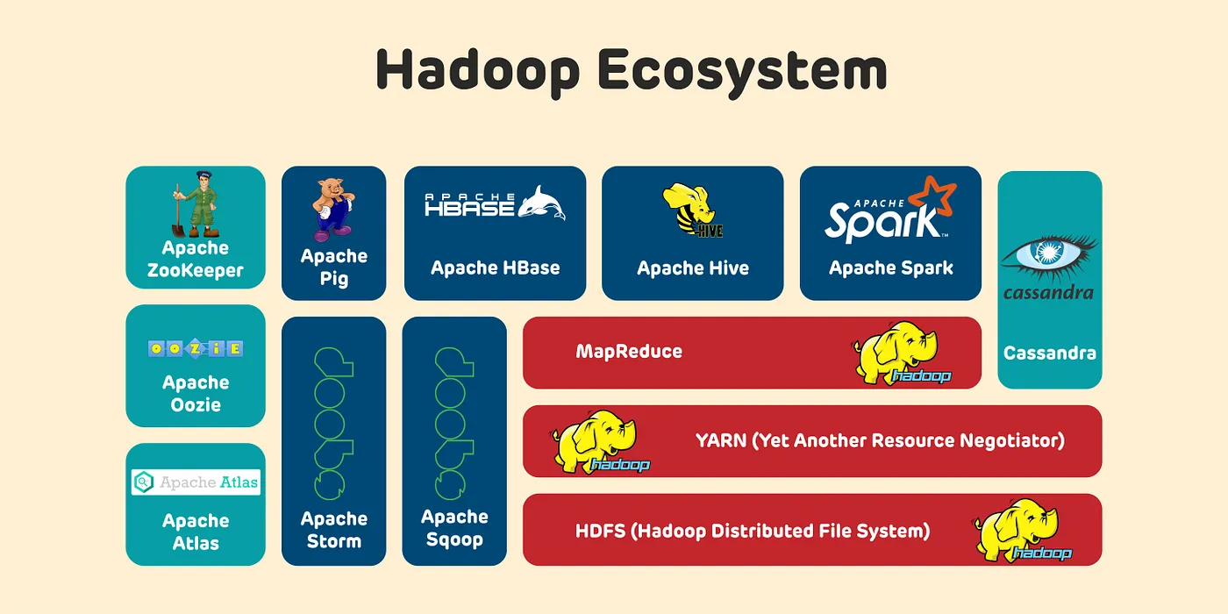

Slide 4
HDFS ( Hadoop Distributed File System)
Manages and stores data in distributed system.
Mandatory part of Hadoop ecosystem.
Like file system
HDFS divides data into different partition each of 128 MB by default and saved into different clusters.

Slide 5
HDFS ( Hadoop Distributed File System)
Master node of HDFS contains metadata that stores location where which data is stored in which node.
HDFS uses concept of replication of minimum 3 copies in different node so we can use it in case of failure.
Main node is primary node and other nodes are secondary.

Slide 6
YARN(Yet Another Resource Negotiator )
Resource management and job scheduling.
Like operating system
Flume and Sqoop
Used for data collection and injection
Data comes to Hadoop through flume and Sqoop
Sqoop for structured data and flume for unstructured and real time data.

Slide 7
HBase
Stores data in column base.
Stores unstructured data using NoSQL.
Hive
Used for analyzing and viewing data.
To use SQL in Hadoop system for structured data.

Slide 8
Mahout
Add features of machine learning in Hadoop system.
Cloudera
Provides user interface for user to input and view result.

Slide 9
MapReduce
Manages and stores data in distributed system.
MapReduce is processing element of Hadoop.
MapReduce process query of user and access data parallelly in key value pair.
Data is reduced into key value pairs and uses divide and concur.
Performs the processing of large amount of data in distributed and parallel manner.
9

Slide 10
MapReduce
Consists of two main tasks: Map and reduce.
In map phase data is mapped into smaller chunks and a map function is applied to each chunk to process and transform it into set of key value pairs.
The key-value pairs are shuffled and sorted to group all the values associated with same key.
Finally and reduced function is applied to each group to produce final result.
10

Slide 11
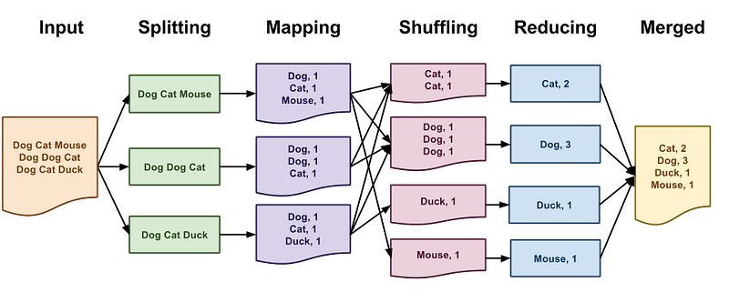
MapReduce example

Slide 12
thank you
Ujjwal gautam
MDS
Sem I
Roll no : 34

